Slide 1
HRA LEGAL UPDATE
September 18, 2025
Beau Wilson, Esq.
Hyland Levin Shapiro LLP

Slide 2
Topic: Speech
New Jersey’s Expansion of Employer Speech
&
Social Media Posts

Slide 3
Captive Audience Restrictions
September 3, 2025 Gov. Murphy signed into law certain restrictions on employer’s “Captive Audience” meetings
Questions:
  What is a “Captive Audience” meeting?
  What are employers prohibited from requiring?
  What can employers still do?

Slide 4

Captive Audience Restrictions (cont.)

Slide 5
Captive Audience Restrictions (cont.)
What is it?
  A captive audience meeting is a mandatory meeting held during working hours, organized by an employer
What is prohibited?
  Cannot require attendance for meetings that involve:
    Religious matters
    Political matters (expanded definition)
    Decisions about whether to fight against, join, support, etc. labor unions or other associations
Notes:
Actual act defines political matters to include “matters which relate to an electioneering communication and the employee’s decision to join or support and political party or political, civic, community, fraternal or labor organization or association”

Slide 6
Captive Audience Restrictions (cont.)
What do employers need to know
  Cannot mandate attendance for these meetings or take any adverse action against an employee who does not voluntarily attend
  Posting requirement (no flyer yet)
  Act goes into effect in December 2025
Interaction with the NLRA
  2024 the NLRB changed position and now prohibits captive audience meetings (with certain exceptions)
  February 2025, NLRB’s general counsel issued a memorandum, which provided the opinion that a prohibition on captive audience meeting was unlawful
  Spoiler: more confusion to come with possible preemption doctrine

Slide 7
Social Media Guidance
Can an employee who work at a private employer make the following post without fear of an adverse action (real life examples):
  Posting antisemitic remarks suggesting support of the Holocaust
  Posting remarks about Chief Justice Roberts and how his “life needs to be shortened” after SCOTUS upheld vaccine mandates
  Posting remarks about how the failed assassination attempt on then former President Trump was a “disappointment”
  Video of an individual describing himself as a fascist
Notes:
In light of Charlie Kirk assassination

Slide 8
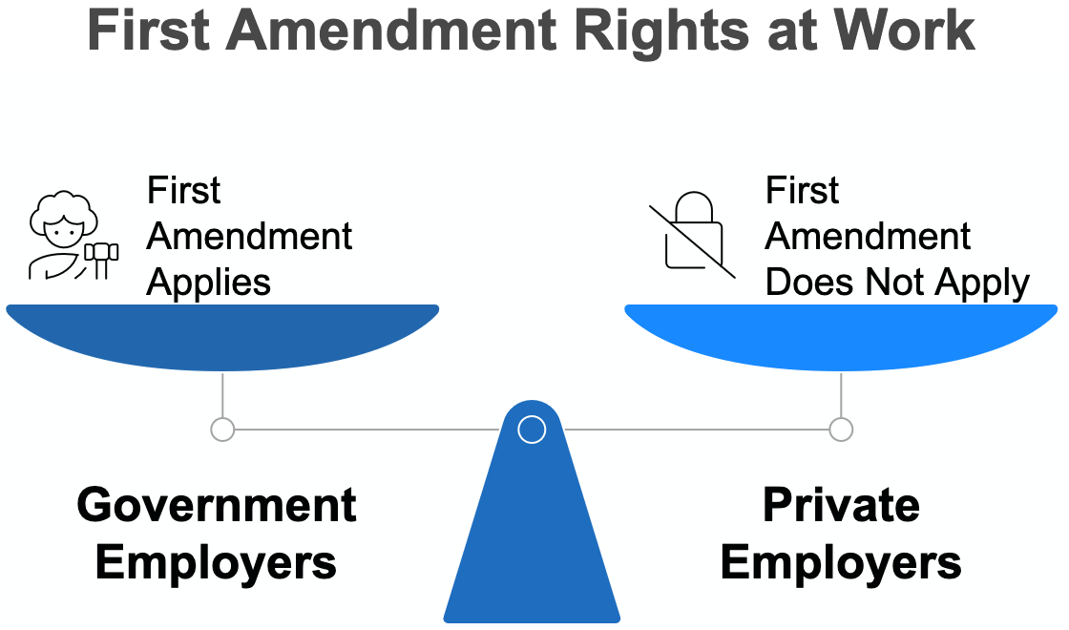
Social Media Guidance (cont.)

Slide 9
Social Media Guidance (cont.)
At-will employment means an employer can terminate you for any reason – or no reason at all
  Is that the reality in New Jersey?
Employers are allowed to take action if your social media posts:
  Conflict with your employer’s values
  Threaten the company’s reputation
  Suggest behavior that could harm workplace productivity
Posts that could harm reputation, harm relationships with clients, or indicate unprofessional conduct may serve as grounds for disciplinary action

Slide 10
Social Media Guidance (cont.)
Know your Company’s social media policy
Tell employees:
  Review the social media policy (should be in your handbook and/or shared during onboarding)
  Understand privacy settings
  Pause before you post
  Separate professional and personal profiles
  Ignoring the guidelines is not an excuse

Slide 11
Social Media Guidance (cont.)
Restrictions that should be in any social media policy
  Derogatory comments
  Offensive or inappropriate content
  Illegal activity
  Unprofessional behavior (may be industry specific)

Slide 12
Social Media Guidance (cont.)
Exceptions: Concerted Activity
  NLRA details that employers cannot discipline non-supervisory employees who act with co-workers to address work-related issues
  I.e. talking with each other about wages, benefits, working conditions, etc.
Conscientious Employee Protection Act (CEPA)
  Cannot discipline an employee for complaining about discrimination or harassment AND cannot retaliate for an employee’s objection to what he/she “reasonably believes” is a fraudulent, illegal, criminal, etc. activity

Slide 13
Questions?
Beau Wilson
Wilson@hylandlevin.com
856-355-2931

