Slide 1
HRA LEGAL UPDATE
November 20, 2025
Beau Wilson, Esq.
Hyland Levin Shapiro LLP

Slide 2

Notes:
Knocking on wood – it has been relatively quiet!

Slide 3
Huge updates in New Jersey/Federal employment requirements since 2020
NJ WARN Act
Stricter worker misclassification and wage laws
NJFLA expansion
Numerous changing guidance for NJLAD claims
NJ State minimum wage
Pay Transparency
DEI-related policies
AI Policy
EEOC changes, quorum, etc.
Pregnant Workers Fairness Act/PUMP Act
FTC’s position regarding non-compete agreements
Notes:
Just some of the most obvious major changes that have occurred over the past 5 years
If you feel stressed, we understand

Slide 4
2026 Updates: Relatively Quiet
Three relatively minor updates:
  Governor-elect Sherrill
  Captive Audience meetings
  One case: ZJN, LLC v. NJ Dep’t of Lab. and Workforce Dev.

Slide 5
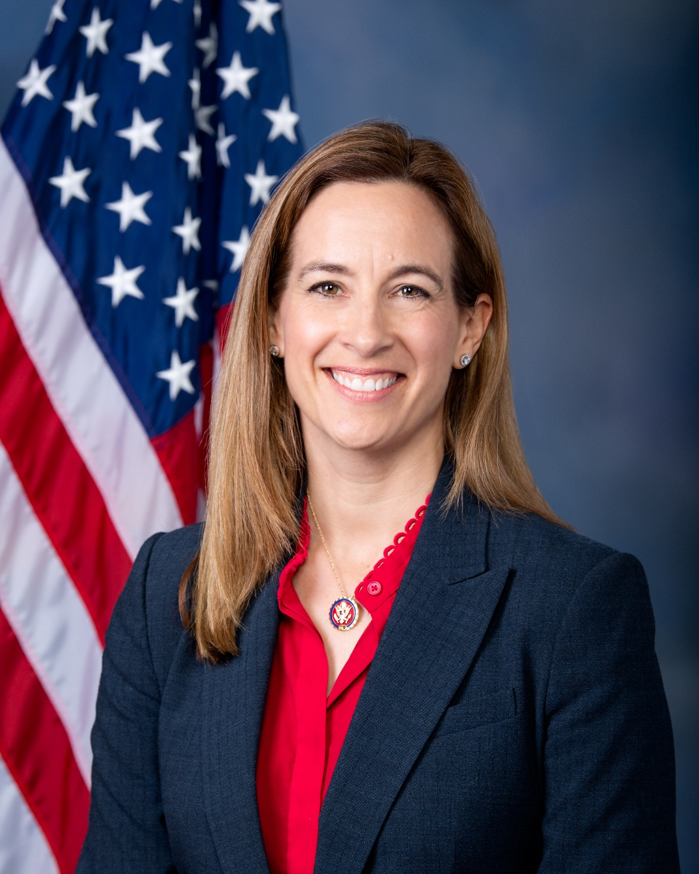
Governor-elect Sherrill
Described as a “middle-of-the-road” Democrat
We expect substantially similar actions and continued policies from Murphy administration
Campaigned on cutting permitting/licensing wait times and expanding the Business Action Center so small businesses may benefit
Also campaigned on energy costs and clean energy so we expect solar options, incentives, etc. to be a focus

Slide 6

Captive Audience Restrictions
What is it?
  A captive audience meeting is a mandatory meeting held during working hours, organized by an employer
What is prohibited?
  Cannot require attendance for meetings that involve:
    Religious matters
    Political matters (expanded definition)
    Decisions about whether to fight against, join, support, etc. labor unions or other associations

Slide 7
Captive Audience Restrictions
What is it?
  A captive audience meeting is a mandatory meeting held during working hours, organized by an employer
What is prohibited?
  Cannot require attendance for meetings that involve:
    Religious matters
    Political matters (expanded definition)
    Decisions about whether to fight against, join, support, etc. labor unions or other associations

Slide 8

ZJN, LLC v.
NJ, DOL
Notes:
This involved a New Jersey Wedding DJ services company.
The DOL alleged that ZJN misclassified its entertainers as independent contractors rather than employees and demanded nearly $50,000 in fees against the company

Slide 9
ZJN v. DOL
What happened (note: this is an unpublished opinion)
  DOL claimed that a DJ company’s contractors should have been classified as employees under the ABC test
  DOL noted that the DJs/entertainers were “not free from the employer’s discretion and control”
    The services performed were at “temporary work sites” that belong to the employer’s clients, which the DOL “can be considered an extension of the employer’s workplace”
    The entertainers did not independently establish their own businesses
  Despite the DJs being able to negotiate their own rates, sometimes being directly paid by the clients, using their own equipment, having little to no supervision from ZJN, and were free to accept, reject, or decline events, the DOL said ZJN was in an employer-employee relationship

Slide 10
ZJN v. DOL
Key parts to note:
  “any service performed for remuneration under an express or implied contract is presumed employment”
  The Court reiterated the ABC test:
    A) Control: individual must be free from control/direction,
    B) Usual course: service is outside the usual course of business and focuses on the place of business (note: East Bay Drywall highlighted the issue with (B) as it relates to remote work
    C) Independent Profession: the individual is engaged in an independently established trade – i.e. will they continue to work in this field even if this particular business goes under? Do they have their own equipment, etc.
  Court also the high deference given to the DOL
Takeaway: New Jersey fairly intent on pushing back on classifying workers as 1099.

Slide 11
Questions?
Beau Wilson
Wilson@hylandlevin.com
856-355-2931

