Slide 1
NEW MEMBER ORIENTATION
Wednesday, 7/12/2023
6:00pm
Zoom

Slide 2
New Member Orientation
About Us
Membership Benefits
Volunteer Opportunities
Affiliations
Events
Website
Q&A

Slide 3
About us
1989
ASPA → SHRM
2023
400+ Members
1946
25 Members
Notes:
Started with a few Personnel Manager getting together to find ways to address the labor shortage with men going to war. Grow into an actual organization with officers and planned meetings and membership…became known as the Personnel Management Association (PMA).
Struggled with the decision to affiliate with ASPA. Afraid to loose its autonomy. Decided the benefits outweighed their concerns. Became chapter #260.
In 1989 ASPA changed to SHRM – name change was to reflect the change in responsibilities of the profession. Subsequently PMA changed to Human Resource Association of So NJ .. Or HRA.
Celebrated our 50th (?) anniversary in 1996.
Have grown from a group of 25 to over 380 members.
Try to keep the relationships and sharing of a small organization while leverage a larger organization that can provide more resources and support for our membership
On website under About Us you can find the bylaws, code of conduct, Goals, Mission / Vision

Slide 4
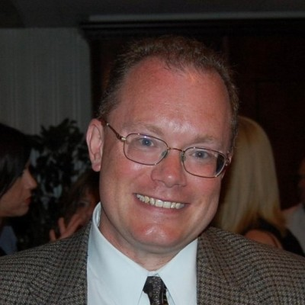
Who’s Who
Officer | Contact information
President Laura Powers SHRM-CP | PSE&G hrlaurakpowers@gmail.com
Vice President Bethann DuBois SHRM-SCP, SPHR | Nipro PharmaPackaging Americas Bethann.dubois@nipro-group.com
Recording Secretary Bruce Dutra | Rowan University dutra.bruce@gmail.com
Treasurer Joe Skwara | Ameriprise Financial Services, LLC joseph.j.skwara@ampf.com
Notes:
Current Officers. Officers are elected for a two-year term.

Slide 5
Networking & Professional Development Opportunities
Book / Video Club
Study Group
HR Q&A
Career Development
Certification Support
Social Events – Holiday Social; Networking Event, Picnic, etc.
Breakfast Roundtables
Webinars
Notes:
We encourage members to become certified and have provided support to pass the exam, ie:
SHRM Learning System – partnered with CCC
Study Group – facilitated by certified members
Information about exams and recertifiation options / scholarships
Recognition of certified members: upon receipt of certification and listed on website.
Recertification credits:
Dinnner Meetings
Breakfast Roundtables (some structure but more interactive than dinner meetings)
Book Club

Slide 6
Dinner Meetings
Typically the 3rd Thursday of each month
All dinner meetings are held at the Ramada in Vineland
Networking: 5:30 - 6:15 pm
Dinner: 6:15 - 7:30 pm
Program: 7:30 - 8:30 pm
* There are no meetings July & August
Notes:
Typically the 3rd Thurs of the Month. .. Except July and Aug.
Try to have a variety of subjects and focus from tactical to strategic and from compliance to organizational development issues.

Slide 7
Volunteer Opportunities
Professional Development
DIVERSITY
Emerging Professionals
Community Outreach
Sponsorship
College Relations
Programs
SHRM FOUNDATION
COMMUNICATIONS
For more information and to view additional committee opportunities visit: http://hrasnj.shrm.org/volunteers
Notes:
College Relations
Committee supports the college outreach initiatives. Chairs acts as a liaison with the Student Chapter Advisor and HRA. Maintains contact with the GSC College Relations Director.
Coordinates activities between HRA and the Student Chapter
Provides information from SHRM to the student chapter advisor, such as scholarships and conferences
Encourages students to attend HRA meetings
Encourages implementation of mentoring program and internship opportunities
Finds opportunities to engage students with chapter initiatives
Communications
Responsible for maintaining the chapter website, overseeing other web networking resources and issuing press releases and newsletters. Purpose of function is to ensure members get information needed and that the chapter and its activities are recognized in the community.
Schedules and issues periodic newsletters to members and prospective members to ensure important information is disseminated
Community Outreach
This committee is responsible for connecting with various community organizations and initiatives. The committee supports and sponsors initiatives such as M25 Coat Drive for homeless, Toys for Tots, Habitat for Humanity, Food Drives, etc.
Attends monthly chamber meetings
Diversity
Purpose is to encourage the chapter and its members to be aware of diversity and inclusion, the benefits of same and ways in which to encourage awareness and acceptance.
Highlight and sponsor diversity initiatives – meeting topic, seminars, icebreaker
Emerging Professionals
To give back to the HR community, to encourage volunteerism and to develop future leaders on behalf of HRA, this group is open to young HR professionals with eight or less years’ experience. This venue supports and recognizes the future of our profession by assisting in their growth by providing a forum for idea sharing while benefiting from fresh and insightful new ideas and contributions to our profession and association that can be realized by these individuals.
Professional Development
Focus on programs and initiatives that will enhance knowledge and growth of members. Encourage certification through HRCI and make information available on SHRM Learning System.
In-Transition Group
Maintain Job Board on website
Book Club
Study Group
Acknowledge and recognize certification achievement
Breakfast Roundtables
Lunch and Learns
Webinars
Programs
Develops list of diversified meeting for dinner meetings and secures appropriate speakers prior to the program year (Sept-June) commencing. Recommends workshops and seminars that may be beneficial to membership and to the chapter. Coordinates programs with Professional Development Chair on Breakfast Roundtables and other venues.
SHRM Foundation
Communicates to members the work of the SHRM Foundation and encourages individual members to contribute. Coordinate events and initiatives to raise money on behalf of the chapter to donate annually to the SHRM Foundation.
Communicates information about SHRM Foundation to chapter members, via meetings, newsletter and social media
Coordinates annual fundraiser for donation to the SHRM Foundation
SHRM Foundation Scholarships
Sponsorships
Provide financial support to the chapter by publicizing sponsorship opportunities and securing sponsors for dinner meetings, website and other events (such as seminars / workshops). Ensure website has appropriate information on how to sponsor a meeting event or the website, the benefits and costs.
JOIN A COMMITTEE – TAKE A SMALL ROLE AND GROW!
SIGN UP NOW or if unsure, contact Carol Asselta or the VP

Slide 8
Affiliations
National
State
Notes:
The Garden State Council-SHRM (GSC-SHRM), comprised entirely of volunteer leaders, is a professional organization supporting the Human Resources profession and the eleven Society for Human Resource Management chapters based in New Jersey. Founded in 1987, its rich history laid the foundation for its evolution into an influential voice of the Human Resources profession in New Jersey.
GSC-SHRM serves as the state-level affiliate of the Society for Human Resource Management. It provides HR professionals in New Jersey with programs, conferences and more. It supports SHRM initiatives within the state, and also serves as an entry points for HR professionals new to New Jersey or for those in an area not covered by a local chapter.

Slide 9
Discount / Affinity Partners
SHRM National members – discounts on travel, personal services, insurance, professional services and small business services.
GSC (state level) – The Affinity Partners will offer discounted products and/or services to either the individual Chapter member or the member’s company.
HRA Chapter -
part of the Greater Vineland Chamber of Commerce - This membership also provides you as an HRA member to participate in their Member to Member Deals discount program. You must sign in to the Chamber website, For more information, click here and then click on the Member2Member program on the left of the website.
PerkPlus – HRA partnered with them to give you discounts on travel, entertainment, real estate, technology, clothing, food, etc.

Slide 10
Conferences
National – SHRM ANNUAL
June 23-26, 2024
Chicago, IL
State – Garden State Council (GSC)
Annual GSC SHRM Conference
Atlantic City, NJ
Volunteer Opportunities
HRA –
Breakfast Roundtables
Seminars / workshops
October 15-17, 2023
Webinars

Slide 11
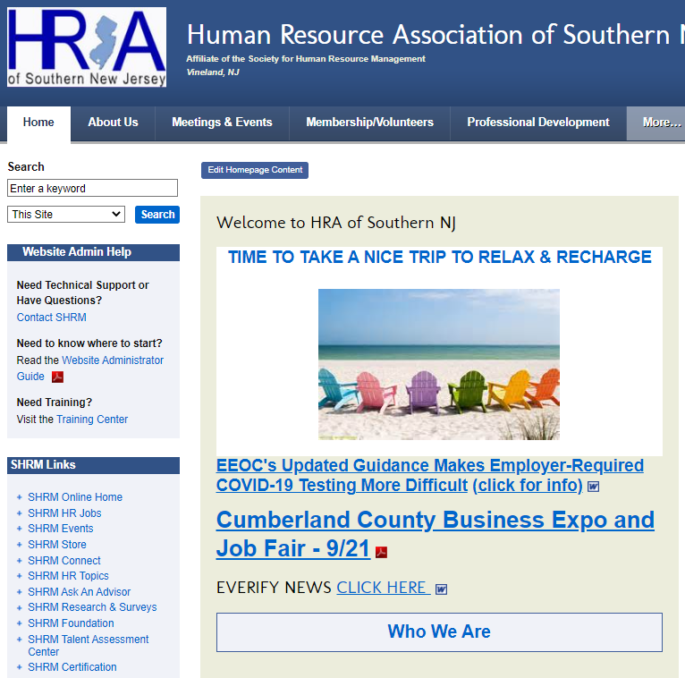
Website Overview

Slide 12
Find Us on Social Media
https://www.facebook.com/HRASNJ
https://www.linkedin.com/groups/HRA-Southern-New-Jersey-2948881/about
Notes:
NEED HELP to make these social media sites more effective for us.
Once we master them, maybe we can do blog (internal to members only) so you can get information or request support.

Slide 13
Questions?
Ready to Make Connections?
Notes:
Introduce each member attending Orientation to an HRA member (buddy) attending dinner meeting, who will introduce them to at least 1 or 2 people they don’t know. Also, recommend they sit with them during the dinner and get to know them and they have a chance to get to know the buddy.
Have pre-arranged and each member of Membership Committee have several participants assigned to them.

